Slide 1

Quiz Feedback

Slide 2
Week 6 Quiz – 5% of overall marks (Quizzes are 20%)

Slide 3
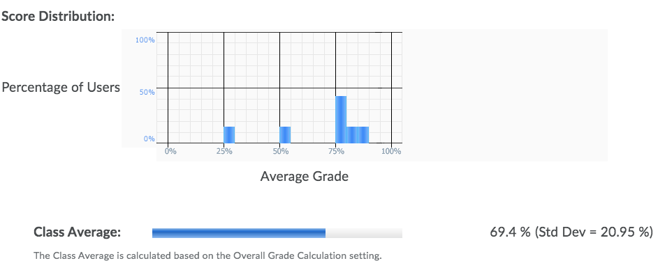
The spread of the grades looked as following:

Slide 4
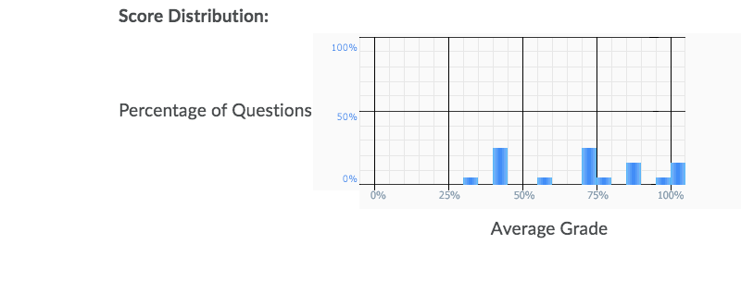
The question statistics looked like this:

Slide 5
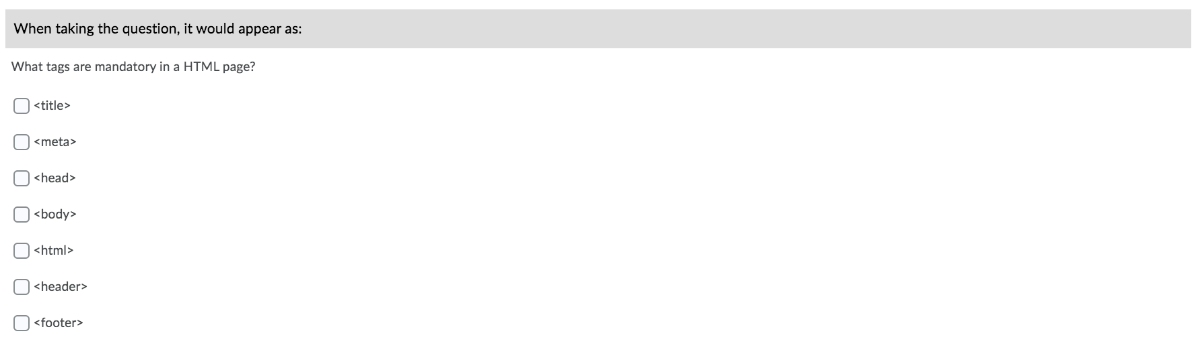
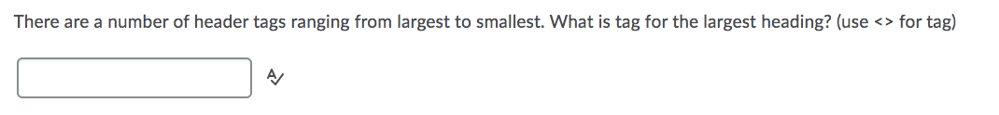
The seven weakest answered questions were..

Slide 6
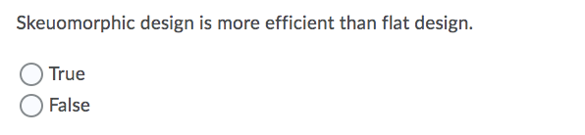

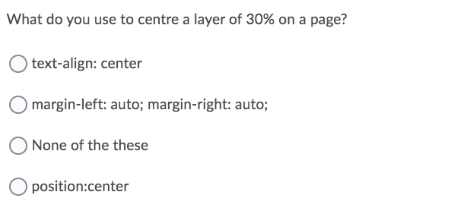
The seven weakest answered questions were..

Slide 7
Strategy of Quizzes going forward
There are 3 more weeks of quizzes – Week 7-9.
They will continue to last 20 minutes.
This week, there are slightly less questions.
This week, some of last week’s questions are reused.

